Slide 1

Django Model
Kusal Bista

Slide 2
Introduction to Django Models
A model is the single, definitive source of information about your data.
It contains the essential fields and behaviors of the data you’re storing.
Generally, each model maps to a single database table.

Slide 3
Example
from django.db import models
class Person(models.Model):
first_name = models.CharField(max_length=255)
last_name = models.CharField(max_length=255)
age = models.IntegerField()

Slide 4
To reflect the changes to database
python manage.py makemigrations
python manage.py migrate

Slide 5
Creating objects
INSERT SQL statement behind the scenes
>>> from myapp.models import Person
>>> b = Person(first_name='Kusal', last_name='Bista')
>>> b.save()

Slide 6
Saving changes to objects
Given a Person instance b that has already been saved to the database, this example changes its name and updates its record in the database:
>>> b.name = 'New name'
>>> b.save()

Slide 7
Common field types
CharField: It is used to define short-to-mid sized fixed-length strings. You must specify the max_length of the data to be stored.
TextField: It is used for large arbitrary-length strings. You may specify a max_length for the field, but this is used only when the field is displayed in forms (it is not enforced at the database level).
IntegerField: It is a field for storing integer (whole number) values, and for validating entered values as integers in forms.

Slide 8
Common field types
DateField and DateTimeField
They are used for storing/representing dates and date/time information (as Python datetime.date in and datetime.datetime objects, respectively). These fields can additionally declare the (mutually exclusive) parameters auto_now=True (to set the field to the current date every time the model is saved), auto_now_add (to only set the date when the model is first created) , and default (to set a default date that can be overridden by the user).

Slide 9
Common field types
EmailField is used to store and validate email addresses.
FileField and ImageField are used to upload files and images respectively (the ImageField adds additional validation that the uploaded file is an image). These have parameters to define how and where the uploaded files are stored.
AutoField is a special type of IntegerField that automatically increments. A primary key of this type is automatically added to your model if you don’t explicitly specify one.
ForeignKey is used to specify a one-to-many relationship to another database model (e.g. a car has one manufacturer, but a manufacturer can make many cars). The "one" side of the relationship is the model that contains the "key" (models containing a "foreign key" referring to that "key", are on the "many" side of such a relationship).

Slide 10
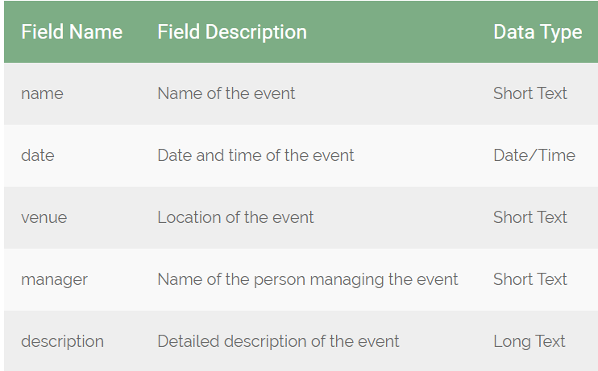
Assignment 3

